Slide 1

Climate Change and machine learning

Slide 2
Climate Change
Climate change has been a hot topic in today’s world.
When analyzing climate change there are many points to consider
Some points include:
Ocean Level
Temperature Levels
Carbon Dioxide levels in the atmosphere
Weather patterns and changes

Slide 3
Machine Learning with Climate Change
There are many types of models in machine learning that can help us gain insight into climate change and identify possible patterns
Regression models can model temperature data
Deep Learning can help predict weather patterns
Models can help analyze forest degradation

Slide 4
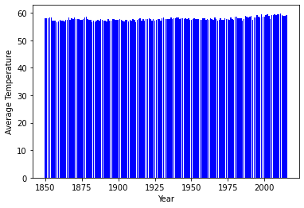
Earth’s Average Temperature
We can see that from just charting the temperatures for the surface temperature over the last 150 years, it is hard to tell whether temperature is going up or down

Slide 5
Linear Regression Accuracy Measurements
Model data
Mean Absolute Error = 6.877
represents the average of the absolute difference between the actual and predicted values in the dataset. It measures the average of the residuals in the dataset
Mean Squared Error = 58.7
measures the variance of the residuals
Further analysis should be completed to see how well model performs on similar data

Slide 6
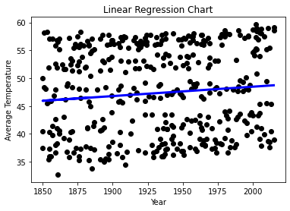
Model Outcome
We can see there is a trend upwards over time. The model will be able to use the data points provided to predict what average temperatures may be over time

Slide 7
References:
Chugh, A. (2020, December 8). Mae, MSE, RMSE, coefficient of determination, adjusted R squared - which metric is better? Medium. Retrieved March 2, 2022, from https://medium.com/analytics-vidhya/mae-mse-rmse-coefficient-of-determination-adjusted-r-squared-which-metric-is-better-cd0326a5697e#:~:text=The%20Mean%20absolute%20error%20represents,the%20residuals%20in%20the%20dataset.
Linear Models. scikit. (n.d.). Retrieved March 2, 2022, from https://scikit-learn.org/stable/modules/linear_model.html#ordinary-least-squares
Earth, B. (2017, May 1). Climate change: Earth surface temperature data. Kaggle. Retrieved March 2, 2022, from https://www.kaggle.com/berkeleyearth/climate-change-earth-surface-temperature-data

